Slide 1
Comparative Analysis between Database and State
BY ANGELO JACKSON

Slide 2

AGENDA
SUMMARY STATS
COMPARATIVE ANALYSIS
TRENDS
RELATIONSHIP ANALYSIS
FINDINGS AND RECOMMENDATIONS

Slide 3
SUMMARY STATS FOR WHOLE DB
The lowest in the East region is Connecticut with 162. 48 average sales in the East region, while New York has the highest sales average with 346.13
The lowest in the Northeast region is Maine with 162.48, while New Jersey takes lead with 346.48
The lowest in the South region is 162. 48, while South Carolina leads with 346.13
The lowest average in the West region is Colorado with 162.48, while ONLINE sales from Colorado takes lead with 346.13

Slide 4

SUMMARY FOR MARYLAND
Maryland takes 25% of the Northest region with their sales.
The lowest performing store would be in Howard County with the count of products being sold is 110, while the store with the highest count of products being sold is Ridgely count with 112 products sold on average.
Technology& Accessories along with Textbooks are the least sold in Maryland.
Maryland has the greatest shift in sales from 2023 to 2024 with a 19.6 % increase.

Slide 5
COMPARATIVE ANAYLSIS
October seems to be the month with the most sales in the Northeast region, while November and December have the lowest sales average in the region.
Maryland performs the lowest in December and January, while they perform well in October, March and August.
The lowest selling product in Maryland is 51 total products sold in Apparel and merchandise, while Textbooks are the highest selling product with 113 total Textbook sold.

Slide 6
TRENDS FOR DATABASE
Total sales revenue across all transactions is $816,057,924.60, while the average transaction amount is $541.59 for the entire database.

Slide 7
MARYLAND TRENDS
Maryland's totals revenue is $68,004,827.05 and $541.59 for the average sales total.
Maryland makes up 8.33% of the database's sales
Maryland generally moves upward in sales with an average of 34% annually.
Generally, makes up 25% of sales in the Northeast Region

Slide 8
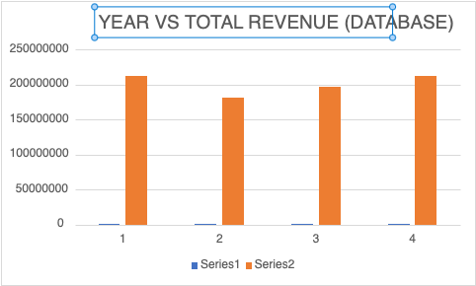
TREND ANAYLSIS IN TOTAL SALES
Here tells you the difference between the entire datbase and Maryland ispecfically to compare the results of total earned revenue for the state and comparing it against the entire database.

Slide 9
Relationship Analysis
In the state of Maryland throughout the years, total revenue has consistently risen every year giving a 4.8% jump from 2022 to 2023, a 19.6% jump from 2023 to 2024, and 7.0% from 2024 to 2025. Making approximately a 30% rise in revenue from 2022.
Meanwhile, according to the entire database, from 2022 to 2023 overall makes a net loss of about 14%, rises from 2023 to 2024 by 8% and from 2024 to 2025 by 8%

Slide 10
Findings and Recommendations
Due to the constant productivity form the state of Maryland, finding out what practices they include in training for salespersons may be useful in raising total revenue across all regions.
Find out what practices would best fit for the lowest performing locations, and use those locations as controlled groups to see how they translate to sales monthly, eventually yearly if successful.

